Slide 1
LEO BANK
Online Banking made easy
By- Vishruti Malviya

Slide 2
Presentation Layout
Objective
Technology Stack
Scope of Project
Outside the scope of the project
Future Work

Slide 3
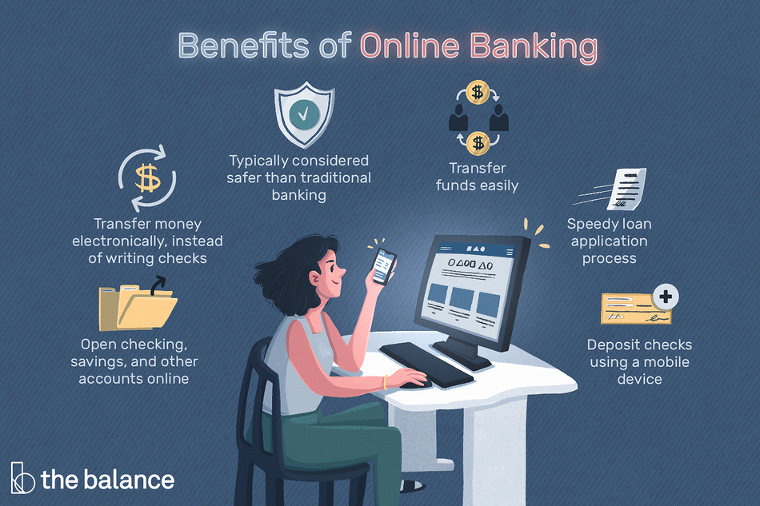
OBJECTIVE
To create a payment wallet application for Leo Bank
Customer will be able to park their money in the wallet
Application allows the customer to create a new account, deposit, withdraw, transfer money, check balance and get transaction history.

Slide 4
TECHNOLOGY STACK
Presentation Layer
Node 12.16.0 (JavaScript Runtime environment)
Angular 6.2.8(Framework to develop webpages)
Business Layer
Java 8(Base Programming Language)
Postman 7.23.0 (for running RESTful service)
Persistence Layer
Hibernate(JPA Implementation)
Oracle 11g (Database Storage)
VS Code 1.44.2 (IDE to develop frontend)
Spring Framework(for creating web services)
Spring Boot 2.3.0( Auto configuring)
Spring Data 2.2.6(Performing repository operations)
Eclipse IDE 4.14.0 (workspace)
DevOps
Maven 4.0.0 (build and manage project)
Hardware & Software Requirements
Windows 10
Google Chrome
RAM 4GB

Slide 5
SCOPE OF PROJECT
Design and Implementation
Create Account
Deposit
The project is designed and developed for Leo Bank to ensure online banking
The new user can create new Account by following few steps
Existing User can deposit money in his account
Withdraw
Check Balance & View User Details
Transfer
Existing User can withdraw money from his account
Existing User can check his balance and check user details
Existing User can transfer money from one account to another
Transaction History
Existing user can view his transaction history
Authorisation & Validation
The Account is authorised and validated for security purpose

Slide 6
OUTSIDE THE SCOPE OF PROJECT
Sending OTPs or messages regarding details of the transactions done to client’s mobile number.
Printing or mailing the transaction history.
Giving loans and other offers to the user.

Slide 7
FUTURE WORK
Microservice Implementation
Social Media Integration

Slide 8
THANK YOU !!!

